Slide 1
Webdriver: Page Object Design Pattern
Jared Sheffer

Slide 2
What is a Webdriver?
A webdriver is a piece of software which allows automated control of a browser.
Examples: Chromedriver, IEDriverServer, Geckodriver
Selenium- Uses all of the above drivers and more
It acts as a common api for multiple browsers
Notes:
Most web browsers will provide their own webdriver for example there is the chromedriver for chrome, iedriverserver for ie, geckodriver for firefox
Selenium Web Driver is a tool for writing automated tests of websites. It aims to mimic the behavior of a real user, and as such interacts with the HTML of the application.

Slide 3
What is Selenium WebDriver?
Selenium accepts commands and sends them to the browser
Selenium has implantations in most modern languages
JavaScript, C#, Python, Ruby, Perl, Java
Selenium is helping to develop the Webdriver standard. https://www.w3.org/TR/webdriver/
This allowed for developers to create Domain Specific Language
Examples:
WebdriverIO- Javascript
Watir – Ruby
Notes:
Most web browsers will provide their own webdriver for example there is the chromedriver for chrome, iedriverserver for ie, geckodriver for firefox
Selenium Web Driver is a tool for writing automated tests of websites. It aims to mimic the behavior of a real user, and as such interacts with the HTML of the application.
These wrappers of Selenium Webdriver allowed developers to enhance and add additional functionality on top of the standard selenium webdriver

Slide 4
How does a WebDriver drive the web?
A webdriver will provide commands
Click, hover, scroll, drag&drop, highlight, execute commands, verify text
username = browser.findElements(:id -> “username”) – Find element
username.hover - hover
username.visible? – returns true is element is visible
username.click – clicks on an element
Notes:
Most web browsers will provide their own webdriver for example there is the chromedriver for chrome, iedriverserver for ie, geckodriver for firefox
Selenium Web Driver is a tool for writing automated tests of websites. It aims to mimic the behavior of a real user, and as such interacts with the HTML of the application.
These wrappers of Selenium Webdriver allowed developers to enhance and add additional functionality on top of the standard selenium webdriver

Slide 5
What is a PageObject?
Purpose:
Reduce duplicate code
Increase maintainablity
Each unique screen on a webapp is a page can be created as a PageObject
Page objects are collections of
Elements
Functionality (Methods)
Notes:
A Page Object simply models these as objects within the test code.
Reduces the amount of duplicated code and means that if the UI changes, the fix need only be applied in one place.

Slide 6
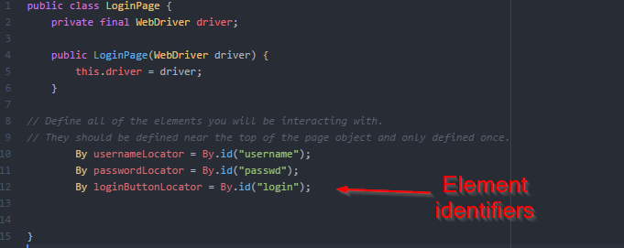
What is a PageObject?
Notes:
The main part of the pageobject is the element locators or identifers.
This is how the developer identifies the element on the page
This should the only place locators are used or defined.
By doing this it means if the locator ever changes you only change it in one place instead of multiple places.

Slide 7
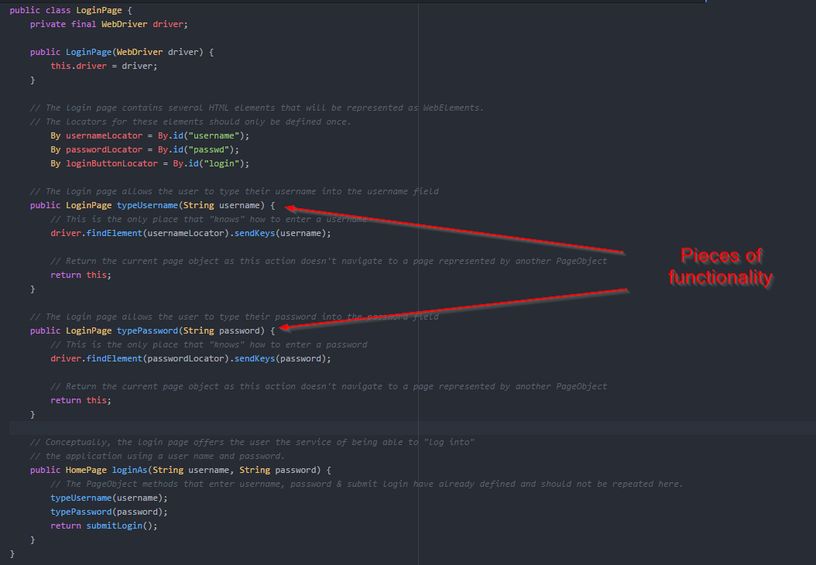
What is a PageObject?
Notes:
We can then reuse the locators within methods.
We have two methods here which are unique pieces of functionality which will likely be used in multiple places
They each take an string and enter it into the correct field

Slide 8
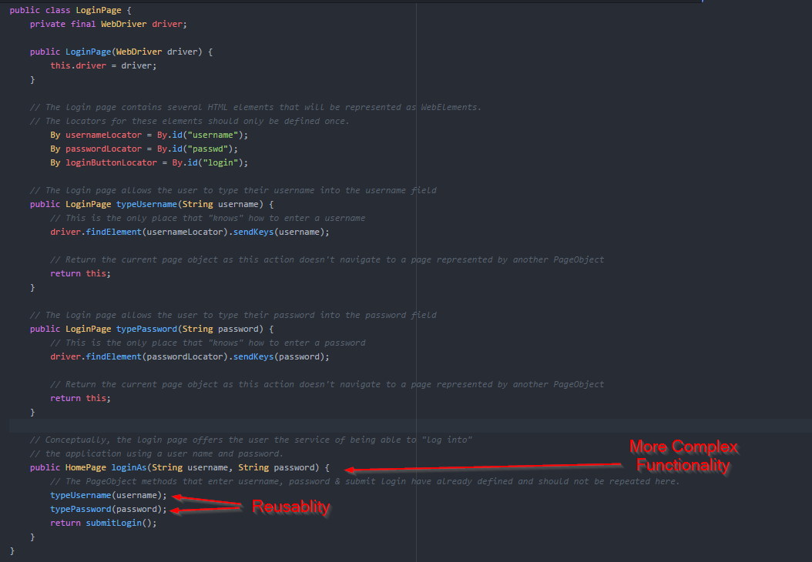
What is a PageObject?
Notes:
Then building off of that we use those methods as a larger piece of functionality to actually do a whole login

Slide 9

PageObject Common Patterns: Navigation
Navigation can make things much more simple
Best if done at the beginning
Reduces code duplication
Simplifies step definintions
Notes:
A Page Object simply models these as objects within the test code.
Reduces the amount of duplicated code and means that if the UI changes, the fix need only be applied in one place.
This is one of my steps which I include in every project I lead. This is a only line step which allows me to navigate to any page within my application

Slide 10
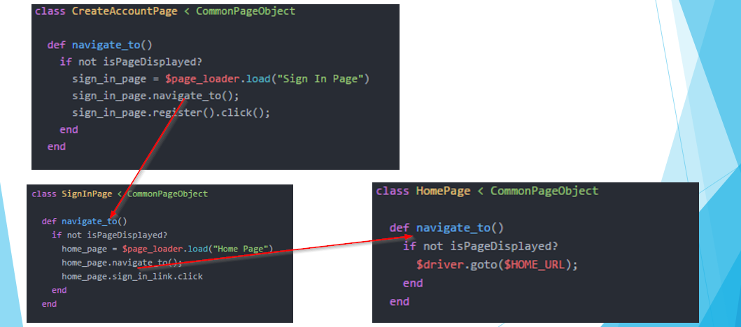
PageObject Common Patterns: Navigation
Each navigation builds off of one another
Notes:
In this example when you call createAccountPage.navigate_to
It will check to see if it is already on the createAccount page and if not it will execute its logic to get there and it knows there is really only one path to create account and that is through sign in
So createAccount.navigateToWill call SigninPage.navigateTo and click register.
So ultimately if it cant find what page it is on them createAccountpage will call createAccount.navigateTo which will call SigninPage.navigateTo → Homepage.navigateTo
Then click the singin link on the homepage
And click the register link on the sign in page

Slide 11
PageObject Common Patterns: Navigation
This means that the following all execute the same code.
Given I navigate to the “home” page
Given I navigate to the “sign in” page
When I navigate to the “create account” page
Notes:
In this example when you call createAccountPage.navigate_to
It will check to see if it is already on the createAccount page and if not it will execute its logic to get there and it knows there is really only one path to create account and that is through sign in
So createAccount.navigateToWill call SigninPage.navigateTo and click register.
So ultimately if it cant find what page it is on them createAccountpage will call createAccount.navigateTo which will call SigninPage.navigateTo → Homepage.navigateTo
Then click the singin link on the homepage
And click the register link on the sign in page

Slide 12
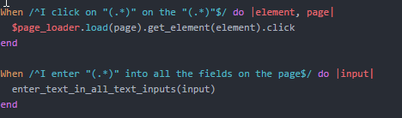
PageObject Simple Interactions
Notes:
The page object model allows me to do things like this
I click on blank on the blank page.
I never have to write any other step which does that
I also have a method which will insert a given text into all the fields on the page.
This is useful if I need to fill out a form but it doesn’t matter what is in them.

Slide 13
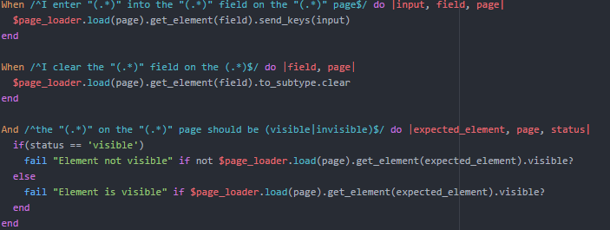
PageObject Simple Interactions
Notes:
The top one lets me enter any text into any field on any page with one line of code
The next one lets me clear the text out.
And the last step will allow me to validate the visibility of any element on any page

Slide 14
Questions?
Notes:
The top one lets me enter any text into any field on any page with one line of code
The next one lets me clear the text out.
And the last step will allow me to validate the visibility of any element on any page

